Slide 1
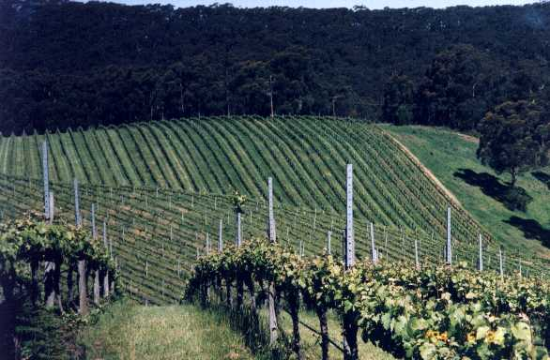
Harvesting operation

Slide 2
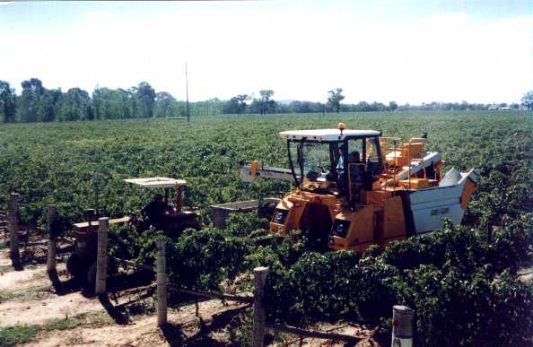
Mechanical harvesting

Slide 3
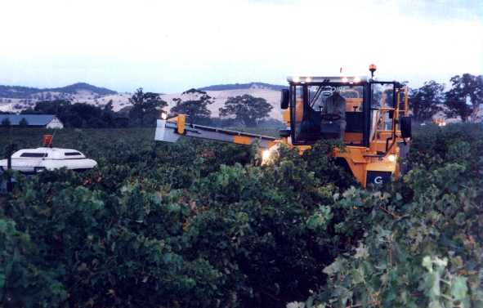
What are we doing?
Machine harvesting of grapes is not an exact science nor is it necessarily complex.
It can be very easy or it can be very difficult to achieve a good result.
The important thing is to understand what you are trying to achieve, what adjustments are available and what impact those adjustments have.
Whatever you do MUST be done safely. ALWAYS follow safe working practices.

Slide 4
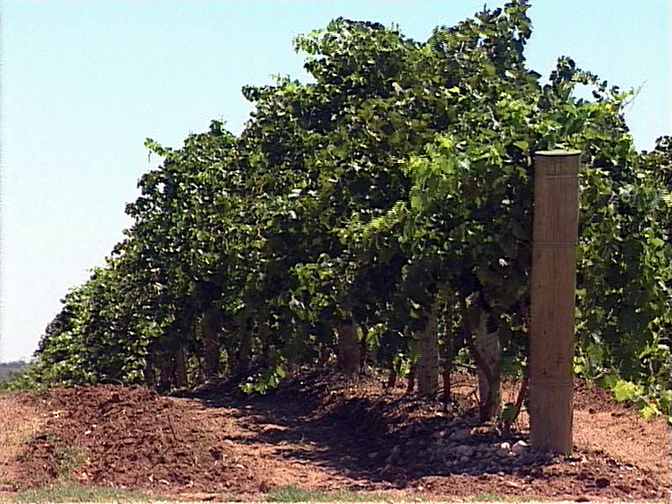
What do we want?
The main outcomes of mechanical grape harvesting are:
maximum fruit removal
minimum vine damage
minimum trellis and post damage
minimum MOG (matter other than grape)
optimum harvesting speed

Slide 5
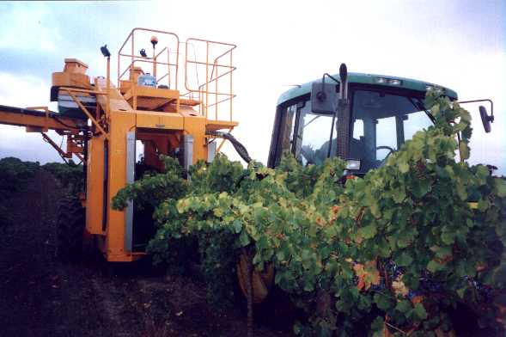
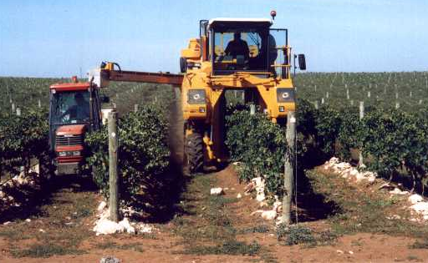
How do we get it?
Factors affecting these outcomes:
picking head position (head centred)
picking head speed
picking rod gap (pinch)
harvester ground speed
picking head height
conveyor speed
fan speed
picking rod spacing
picking rod shape
vine condition
trellis condition
vineyard row condition and terrain
weather conditions and time of day
grape variety

Slide 6
Preparing the harvester
centre the picking head within the machine as shown by TVM
if the head is not in the centred then the rods will pick unevenly resulting in poor picking quality, excessive cane damage and trellis and post damage

Slide 7
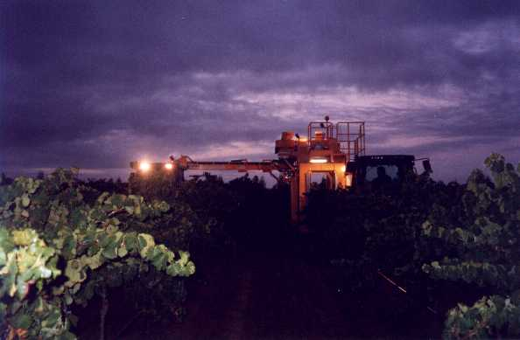
Preparing the harvester
place rods in machine in accordance with manufacturers recommendations
ensure only enough rods to cover the fruit zone
place the lowest rod on the side of the highest catcher plate

Slide 8
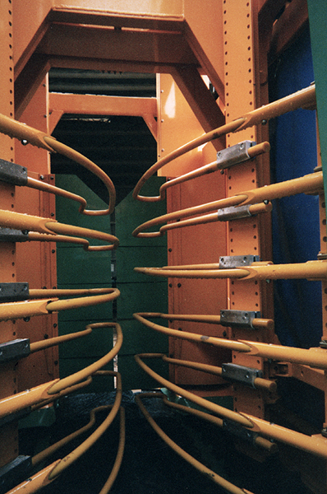
Preparing the harvester
rods should curve inwards going from the front to the rear and have a straight section of about 300 – 400mm then curve slightly outwards for the last 100mm or so (refer drawing)
rods should be horizontal with no twists
all rods should be in a straight line in the vertical plane (refer drawing)
closer rods spacing (around 80mm) may be an advantage for some varieties such as Chardonnay and Cabernet

Slide 9
Set up and operation
At all times think about what you are trying to achieve and how you can achieve it
different ideas on the most important factor eg fruit left behind, broken posts, MOG etc
the operator must endeavour to achieve the best result in all aspects
you will need to develop a trade-off between achieving all the desirable criteria as it is rarely possible to achieve the ‘perfect’ job
speed is the least important factor
get all the other factors as best you can then consider speed but remember that increasing the speed will affect the other factors

Slide 10
Set up and operation
most grapes are harvested with a picking head speed in the range 460 – 530rpm
start with a slower speed then increase slowly until all fruit is being removed then back off slightly from there
rod gap (pinch) should be set according to the canopy width ie the width of the ‘woody’ part of the canopy – generally around 50 – 70mm
if pinch is too wide there will be poor fruit removal and excessive cane and leaf damage
if pinch is too narrow there will be excessive cordon damage and post damage
we want to shake the cordon not hit the fruit!

Slide 11
Set up and operation
conveyor speed will affect MOG removal as well as machine efficiency – generally best to run the belts fast to reduce the fruit content across the belt thus allowing the fans better access to MOG
fans should be run only fast enough to effectively remove MOG – too fast will result in fruit and juice extraction

Slide 12
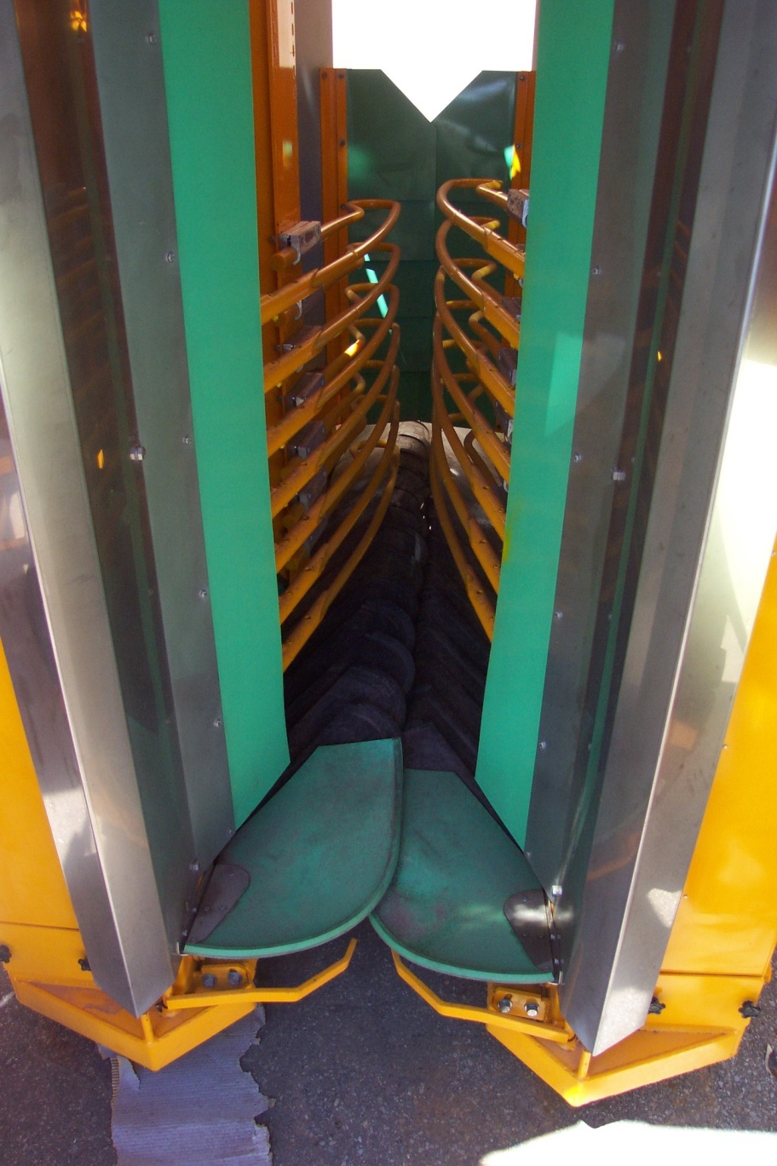
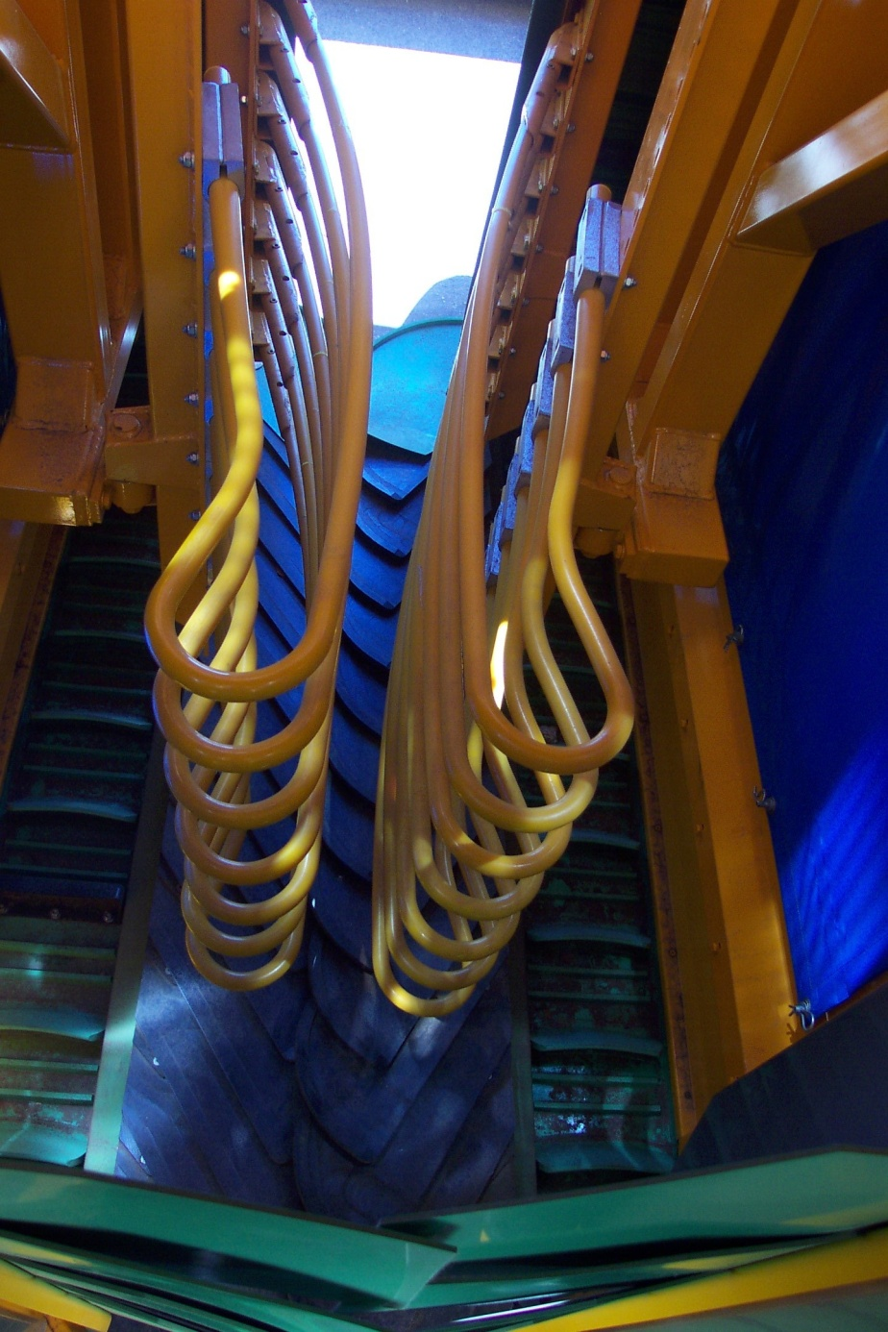

Slide 13
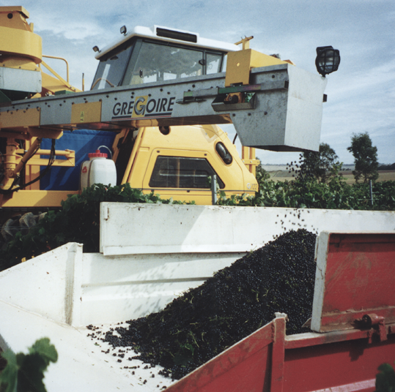
Problems and hints
when it seems that the fruit just won’t come off and nothing seems to work try the following:
observe and think about what’s happening
try to pinpoint a possible cause
maybe make a quantum change to one adjustment
only change one thing at a time
picking grapes is often about making considered compromises

Slide 14
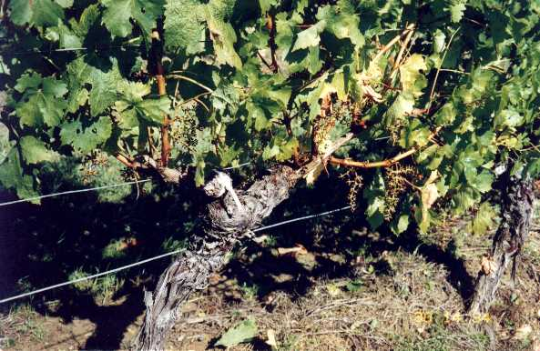
Problems and hints
old woody vines can be difficult – try:
widening the vertical rod gaps in the vicinity of the woody arms
closer gaps in the vicinity of the bunches
adding a couple of rods lower on the trunk with a closer pinch
with this configuration the picking head speed could be reduced

Slide 15
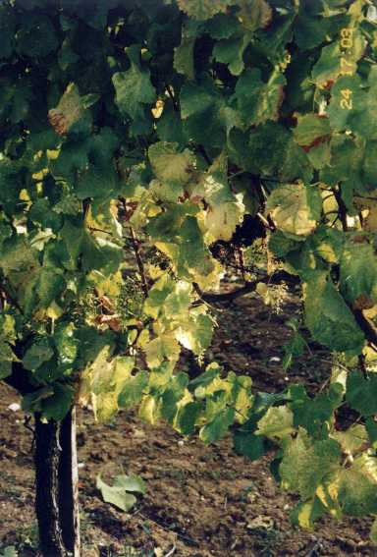
Problems and hints
It is sometimes helpful to operate the harvester with a slight incline from front to rear
When picking vines with two fruit zones there can be wider gaps between the two sets of rods
The rod shape could be altered to help improve picking around the posts – ie pick more with the rod tips. Remember that leaf and cane damage may increase
Sometimes bunches may fall off in front of the harvester as a result of damage or necrosis. When this is a problem try:
altering the rod shape to pick more with the tips and
increase ground speed

Slide 16
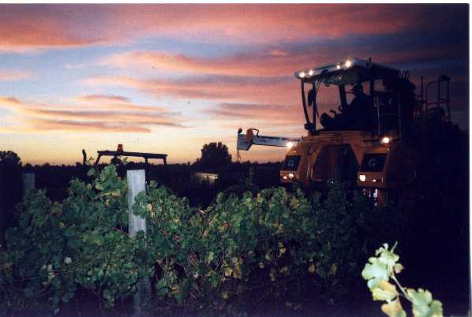
SUMMARY
THINK ABOUT WHAT YOU ARE TRYING TO ACHIEVE
THINK ABOUT WHAT ADJUSTMENTS YOU HAVE
COMPROMISE IS INEVITABLE
GET TO KNOW THE MACHINE
IF IN DOUBT, ASK

